Slide 1

ISE Project
Group 2:
Alaqsa Akbar, 202281480
Abdulilah AlShammary, 202063340

Slide 2
1. Discovery

Slide 3
What Did We Choose
Game development industry can be very random and hard to understand
We want to predict how well received a game would be
We got our dataset from Kaggle:
https://www.kaggle.com/datasets/thedevastator/global-video-game-sales-ratings/data

Slide 4
What Is In The Dataset
Name | The name of the video game. (String)
Platform | The platform the game was released on. (String)
Year_of_Release | The year the game was released. (Integer)
Genre | The genre of the game. (String)
Publisher | The publisher of the game. (String)
NA_Sales | The sales of the game in North America. (Float)
EU_Sales | The sales of the game in Europe. (Float)
JP_Sales | The sales of the game in Japan. (Float)
Other_Sales | The sales of the game in other regions. (Float)
Global_Sales | The total sales of the game across all regions. (Float)
Critic_Score | The score given to the game by critics. (Float)
Critic_Count | The number of critics who reviewed the game. (Integer)
User_Score | The score given to the game by users. (Float)
User_Count | The number of users who reviewed the game. (Integer)
Developer | The developer of the game. (String)
Rating | The rating of the game. (String)

Slide 5
2. Data Preparation

Slide 6
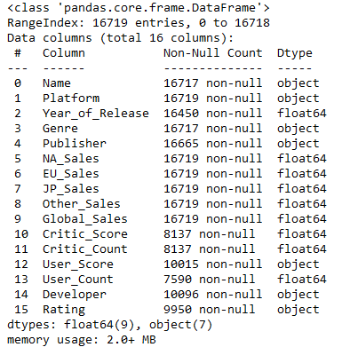
Inconsistencies
Should be a float

Slide 7
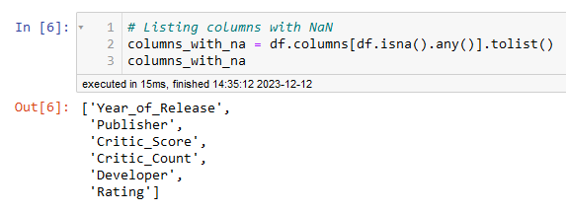
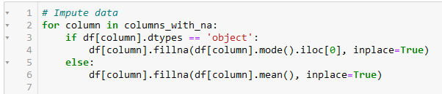
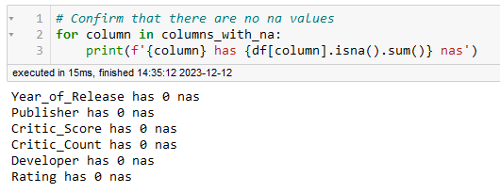
Imputing
We listed the columns with na values
We then imputed data based on data type
We then verified that there are no nas left

Slide 8
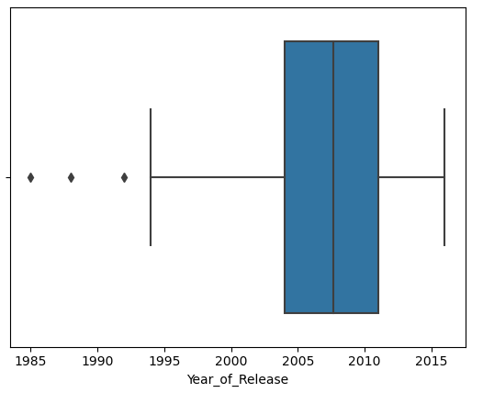
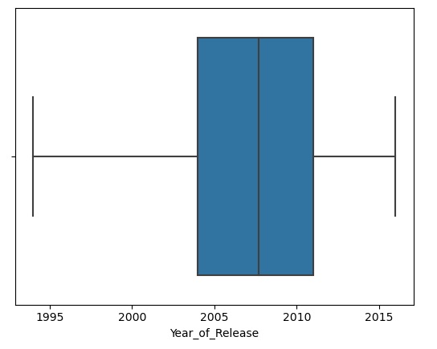
Outliers
Before
Most of the data contained natural outliers, such as Global Sales where sales larger than 0 could be outliers
Year of Release had real outliers
After

Slide 9
3. Model Planning

Slide 10
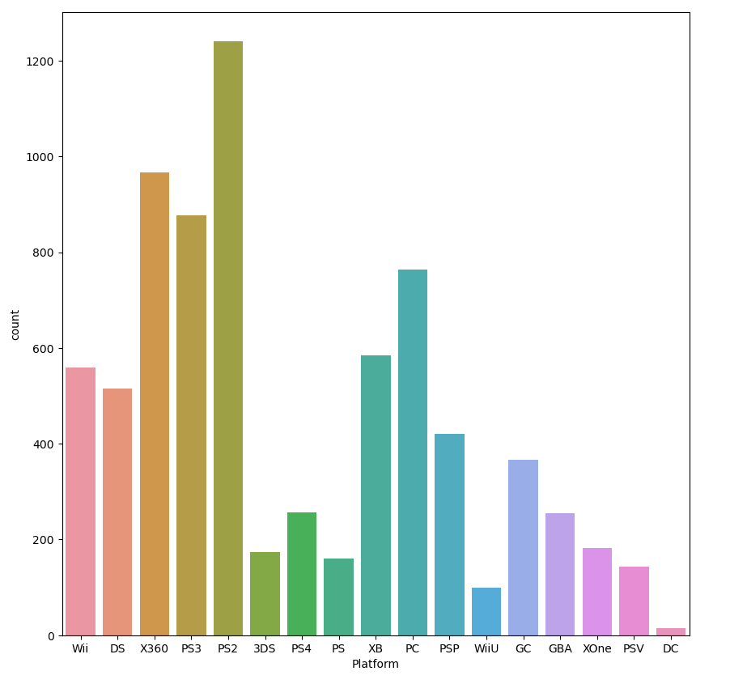
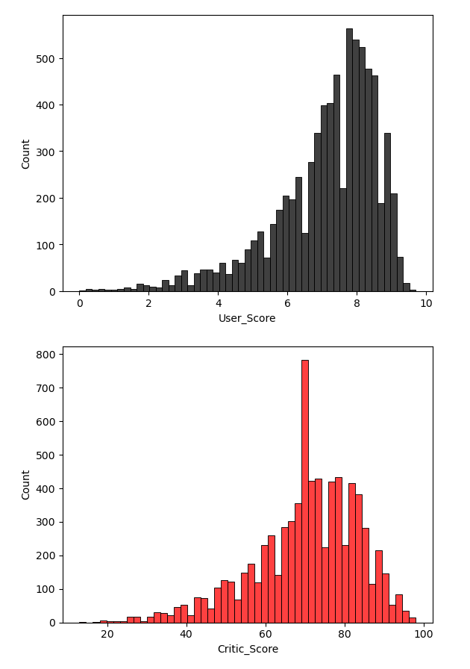
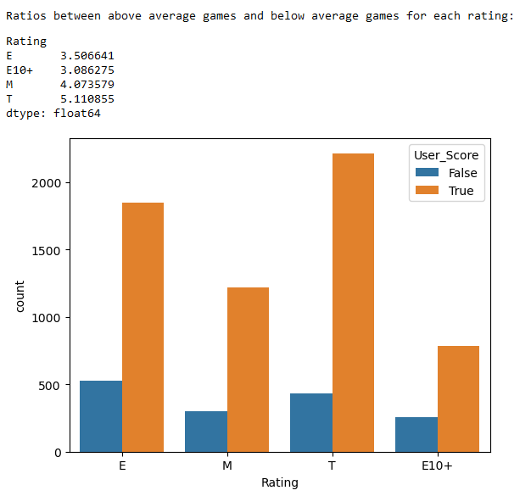
Exploratory Analysis

Slide 11
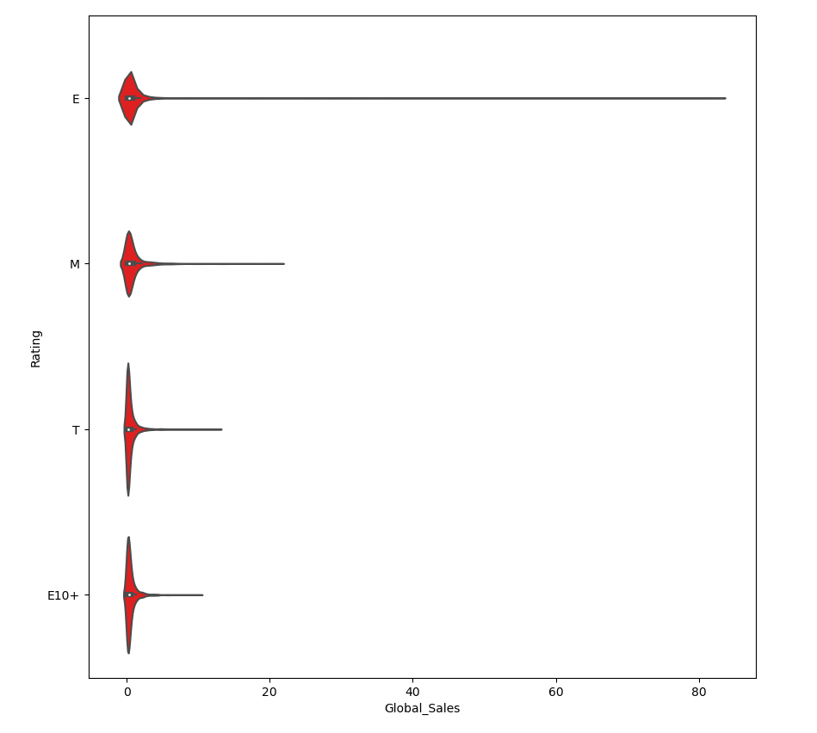
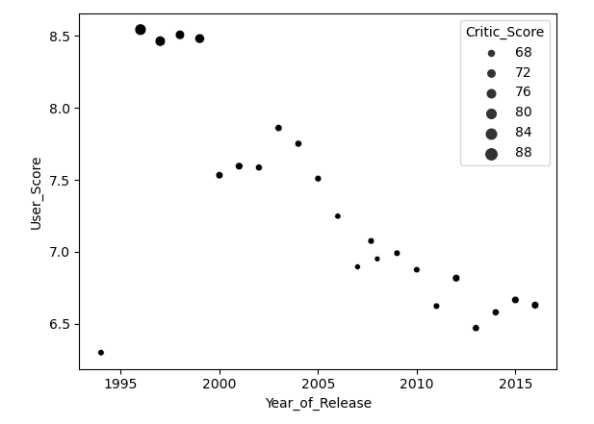
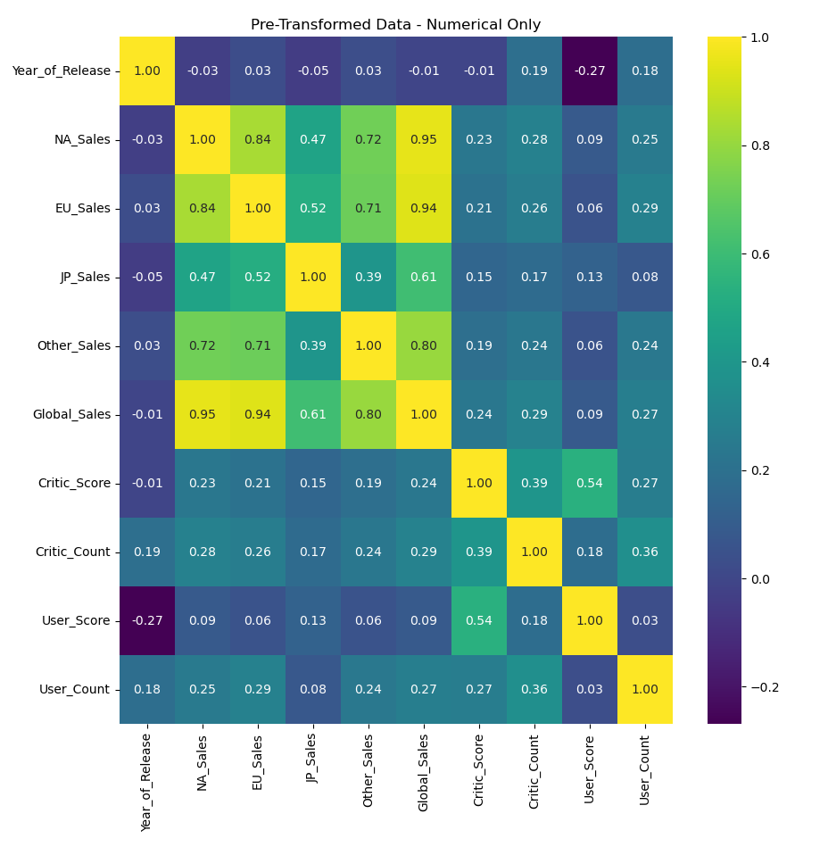
Exploratory Analysis (contd.)

Slide 12
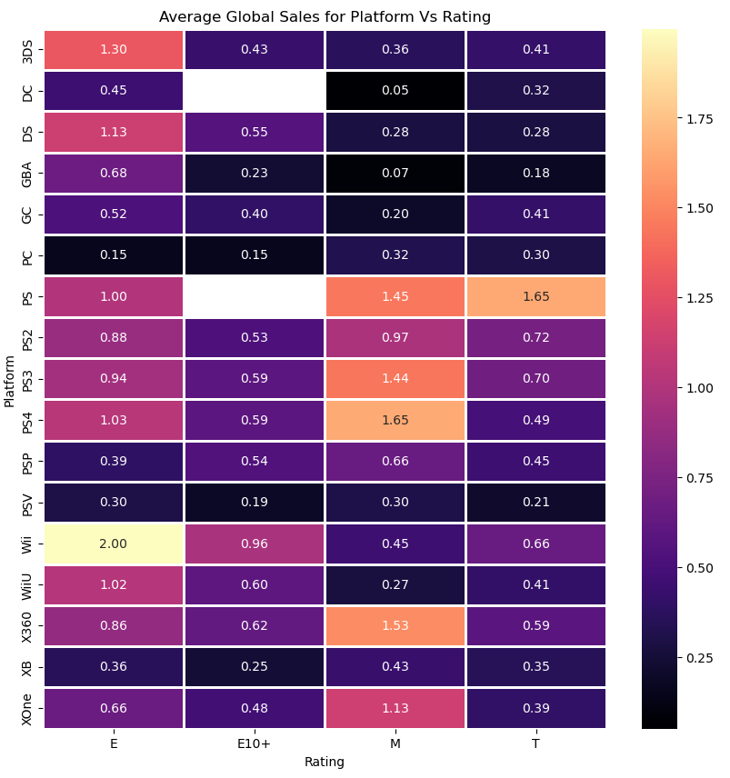
Exploratory Analysis (contd.)

Slide 13
Data Transformation
Platform: One Hot Encoding (Nominal Data / Is not ordered)
Year_of_Release: MinMaxScaler (Year is not normally distributed and has short known range for the numbers)
Genre: One Hot Encoding (Nominal Data)
Publisher: Frequency Encoding (Nominal Data)
NA_Sales & EU_Sales & JP_Sales & Other_Sales: We map it to the proportion of Global_Sales. e.g., for NA_Sales, we use NA_Sales / Global_Sales
Global_Sales: StandardScaler
Critic_Score: MinMaxScaler (range is known (0 - 100 at max))
Critic_Count: StandardScaler
User_Score: MinMaxScaler (range is known (0 - 10 at max))
User_Count: StandardScaler
Developer: Frequency Encoding
Rating: Label Encoding (Ordinal Data / Data is ordered)

Slide 14
4. Model Building

Slide 15
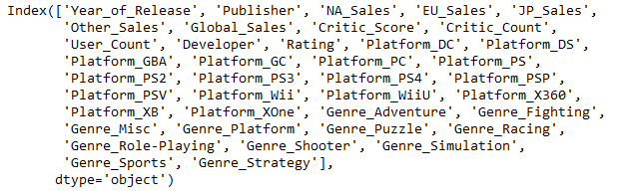
Variables
We want to predict User_Score (dependent variable)
Our independent variables:
We will compare models using MSE

Slide 16
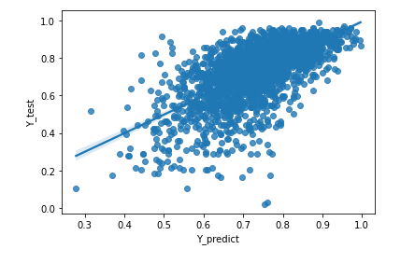
Linear Regression
We use the formula: β=(X^{T}X)−1 X^{T}Y
MSE = 0.0138

Slide 17
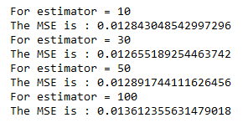
XGBoost
A type of Gradient Boosting known for its efficiency (wins many Kaggle competitions)
Similar to Random Forest
MSE = 0.0127

Slide 18
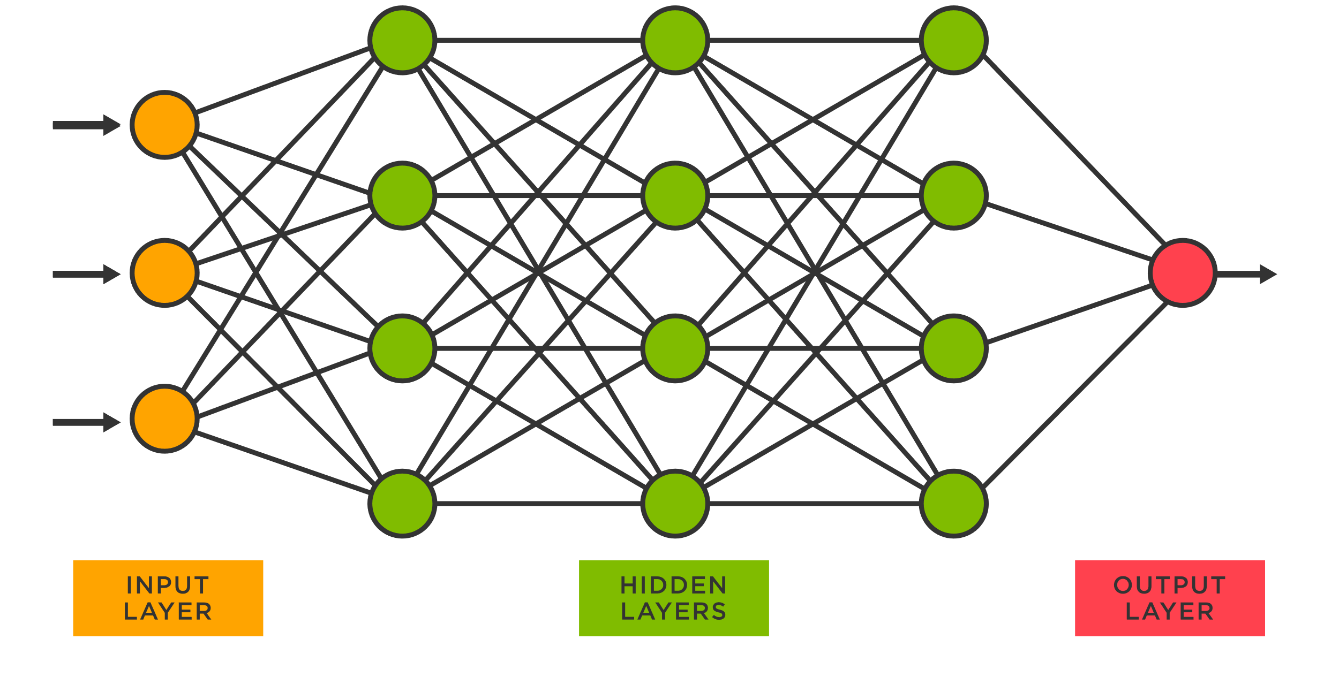
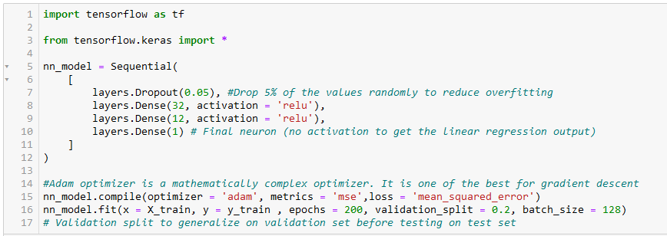
Neural Network
Neural Networks require large datasets as they are complex
MSE = 0.0146

Slide 19
Best Model
Linear Regression MSE = 0.0138
XGBoost MSE = 0.0127
Neural Network MSE = 0.0146
Best model was the XGBoost

Slide 20
5. Operationalize

Slide 21
Problems
The naturally high count of outliers
Lack of understanding why each field affects the result accordingly
Lack of more diverse data
The success of a game depends on outside factors as well
Game success is highly unpredictable
Dataset had too many null values

Slide 22
Possible Improvements
We may use a different data set that has more information, this one had too many null values
We can also use a more diverse data set that gives information on more fields
Our data set was also a bit too small for a proper neural network.

Slide 23
6. Communicate Results

Slide 24
Summary
We managed to create a model (XGBoost Regression) that accurately predicts the User_Score using given data
We achieved our intended goal
We noticed several trends and patterns between different fields. For instance, Sales between US and EU seemed to be correlated as opposted to with Japan.
The correlation between user scores and critic scores is significantly weaker than expected.
Games with E rating sold very well
Games with T rating tended to have better scores as opposed to games with an E10+ rating

